Slide 1
Decision Tree
Mr. Shrikrishna Anand Narvekar
Assitant Professor
Computer Engineering department
Agnel Institute of Technology and Design

Slide 2
Content
Introduction
Decision Tree structure
Example of decision tree
How decision tree is constructed
Advantages and shortcomings of decision tree
Types of decision tree
ID3 Algorithm

Slide 3
Introduction
Decision tree is a type of supervised machine learning where data is continuously split according to certain parameters.
Tree can be explained by two entities, namely decision nodes and leaves. The leaves are decision or final outcomes and decision nodes are the nodes where data is split.
Decision tree consist of three types of nodes: Root Node, Branch Node and Leaf node.

Slide 4
Decision Tree Structure
Each internal node(represented by boxes) test an attribute(represented as ‘A’/‘B’ within the boxes).
Each Branch corresponds to attribute value (T/F)in this case.
Each node assigns a classification.
A
The first node is called ‘root’ node.
Branches from the root node are called as ‘leaf’ nodes.
Here, ‘A’ is root node. ‘B’ is branch node and ‘T’ and ‘F’ are leaf node.
F
T
B
B
F
T
F
T
F
T
T
F

Slide 5
Example of decision tree
Age<30
An example of decision tree can be explained using binary tree.
Let’s say we want to predict whether person is fit or not given their information like age, eating habit and physical activity.
Decision nodes here are Age, Eats junk food?, Does he exercise?.
Leaves are outcomes like fit or unfit?
Yes
No
Eat’s lots of junk food
Exercise in the morning
Yes
No
Yes
No
Unfit
Fit
Fit
Unfit

Slide 6
How decision tree is constructed
The set of records available for developing classification methods is divided into two disjoint subset a training set and a test set. Attributes of the records are categorized into two types:
Attribute whose domain is numerical are called numerical attributes.
Attribute whose domain is not numerical are called categorical attributes.
Decision tree is constructed based on training data and top down strategy.

Slide 7
Decision Tree example
The dataset has five attributes.
There is a special attribute: the attribute class is the class label.
The attributes, temp(temperature)and humidity are numerical attributes.
Other attributes are categorical, i.e. they cannot be ordered .
Based on the training data we want to find set of rules to know whether values of outlook, temperature and humidity and wind determine whether or not to play golf?

Slide 8
Training data
Outlook | Temp(F) | Humidity(%) | Windy | Class
Sunny | 79 | 90 | True | No play
Sunny | 56 | 70 | False | Play
Sunny | 79 | 75 | True | Play
Sunny | 60 | 90 | True | No play
Overcast | 88 | 88 | False | No play
Overcast | 63 | 75 | True | Play
Overcast | 88 | 95 | False | Play
rain | 78 | 60 | False | Play
rain | 66 | 70 | False | No play
rain | 68 | 60 | True | No play
Outlook
Rain
Sunny
Overcast
Humidity
Play
Windy
<=75
true
false
>75
Play
No Play
No Play
Play

Slide 9
Decision Tree
We have five leaf nodes
In decision tree each leaf node represents a rule.
We have following rules corresponding to the tree given in the figure.
RULE 1: If it is sunny and humidity is not above 75%, then play
RULE 2: If it is sunny and humidity is above 75%, then do not play
RULE 3: If it is overcast then Play.
RULE 4: If it is rainy and not windy, then Play.
RULE 5: If it is rainy and windy, then do not Play.

Slide 10
Classification
Classification of unknown input vector is done by traversing the tree from the root node to the leaf node.
A record enters the tree at the root node.
At the root test is applied to determine which child node the record will encounter next.
This process is repeated until record arrives at the leaf node.
All the record that end up at given leaf of the tree are classified in the same way.
Ther is unique path from root to each leaf . Path is the rule used to classify the record

Slide 11
In out tree we can carry out the classification of the unknown record as follows:
Let us assume that for a record we know value of first four attribute (but we don’t know the value of class attribute).
Outlook =rain; temp=70; humidity=65; and windy=True
We start from the root node to check the value of attribute associated with the root node.
This attribute is the splitting attribute at this node.
For a decision tree, at every node there is an attribute associated with the node called the splitting attribute.
In Our example outlook is the splitting attribute at the root.
Since for the given records, outlook= rain, we move to the right most child of the root.

Slide 12
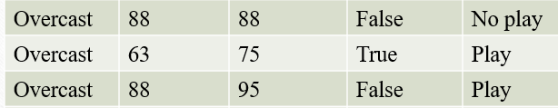
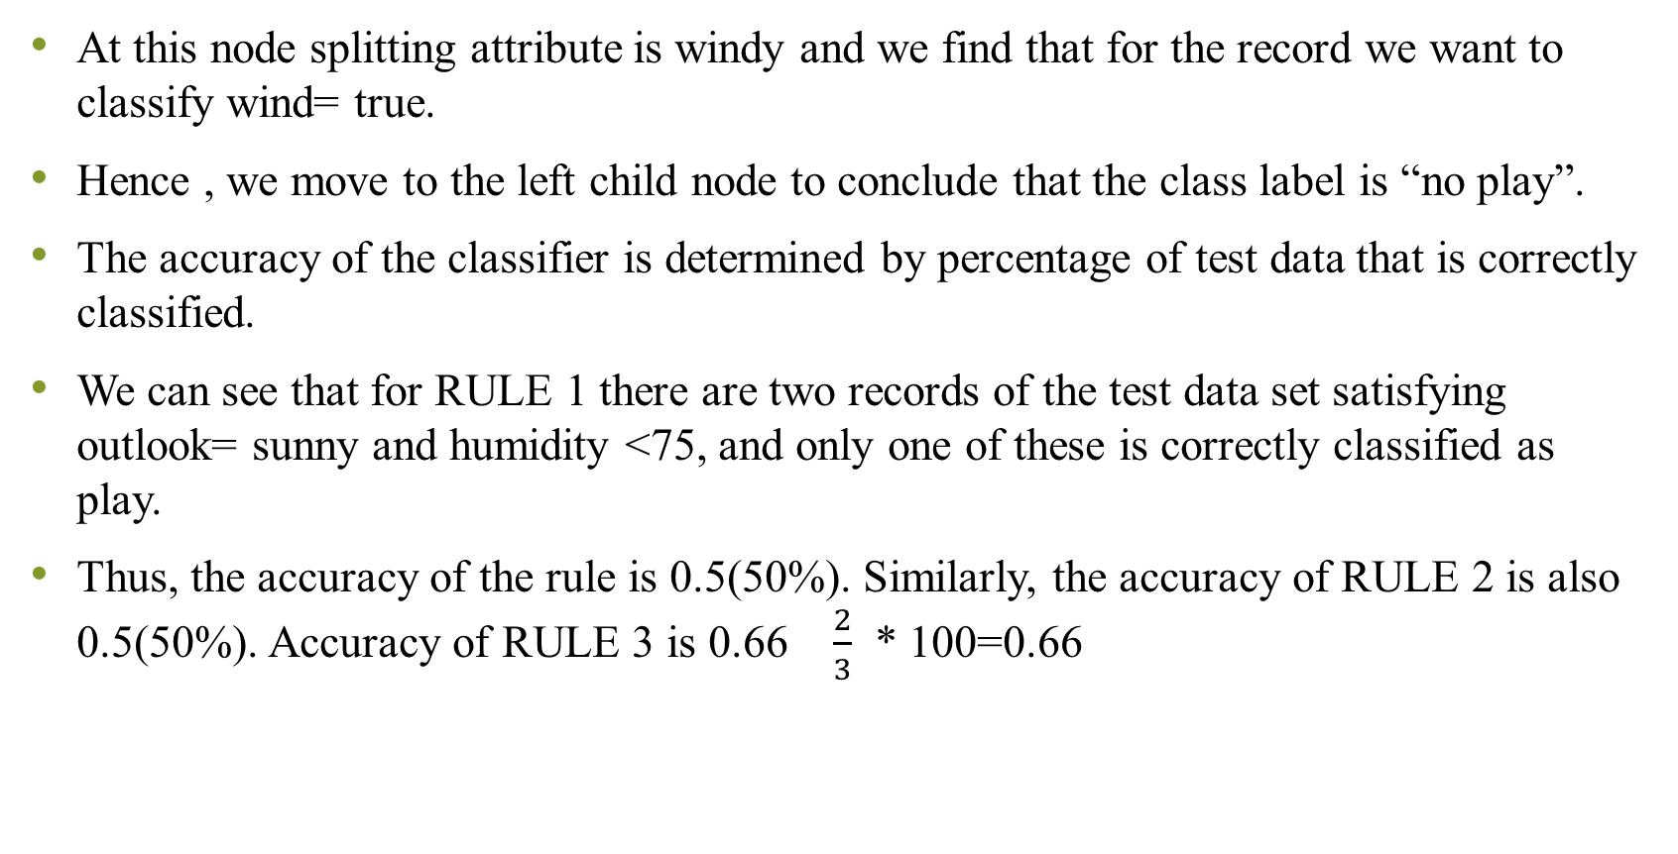
At this node splitting attribute is windy and we find that for the record we want to classify wind= true.
Hence , we move to the left child node to conclude that the class label is “no play”.
The accuracy of the classifier is determined by percentage of test data that is correctly classified.
We can see that for RULE 1 there are two records of the test data set satisfying outlook= sunny and humidity <75, and only one of these is correctly classified as play.
Thus, the accuracy of the rule is 0.5(50%). Similarly, the accuracy of RULE 2 is also 0.5(50%). Accuracy of RULE 3 is 0.66 $\frac{2}{3}$ * 100=0.66

Slide 13
Advantages and shortcomings of Decision Tree
A decision Tree construction process is concerned with identifying splitting attributes and splitting criterion at every level of tree.
Major strength are:
Decision tree are able to generate understandable rule.
Able to handle both numerical and categorical data.
They provide clear indication of which field are most important for predication and classification.
Weakness are:
The process of growing a tree is computationally expensive. At each node each candidate splitting is examined before its best split can be found.
Some decision tree can only be deal with binary- value target classes.

Slide 14
Type of decision Trees
There are two main types of decision trees:
Classification trees(Yes/No: What we have discussed is an example of classification tree where outcome variable are categorical type.
Regression Trees(Continuous Trees):Here, the decision or outcome variable is continuous.
Let’s see how decision Tree works internally. Before we start with algorithm lets understand few definitions

Slide 15
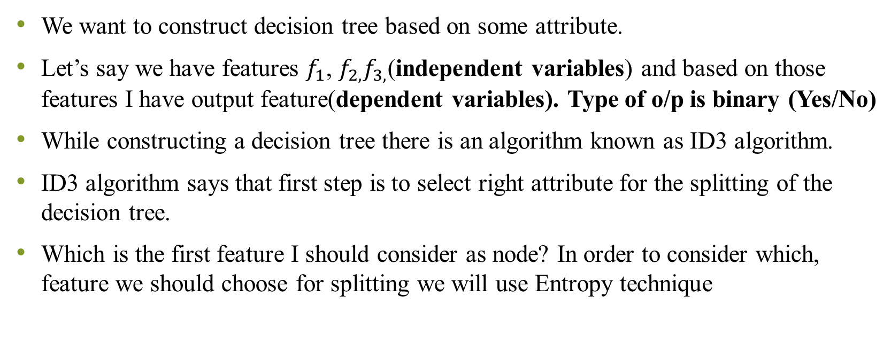
Entropy
We want to construct decision tree based on some attribute.
Let’s say we have features $f_{1}$, $f_{2,}f_{3,}$(independent variables) and based on those features I have output feature(dependent variables). Type of o/p is binary (Yes/No)
While constructing a decision tree there is an algorithm known as ID3 algorithm.
ID3 algorithm says that first step is to select right attribute for the splitting of the decision tree.
Which is the first feature I should consider as node? In order to consider which, feature we should choose for splitting we will use Entropy technique

Slide 16
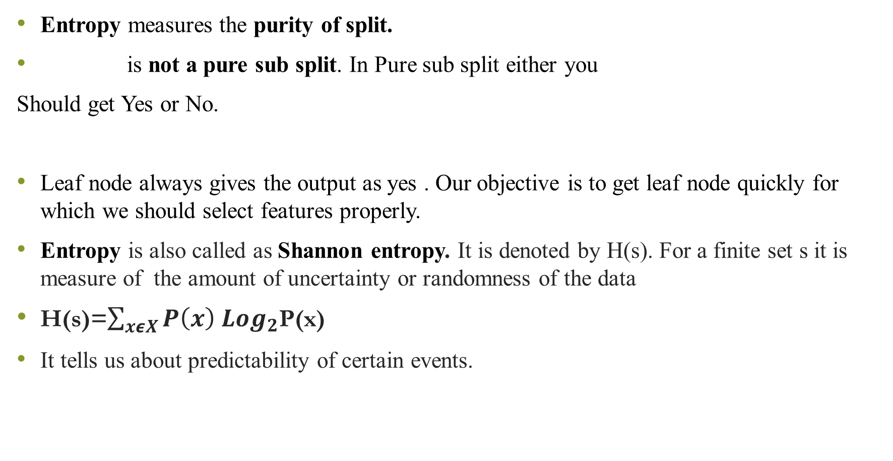



9 yes, 5 No
$$f_{1}$$
Entropy measures the purity of split.
is not a pure sub split. In Pure sub split either you
Should get Yes or No.
Leaf node always gives the output as yes . Our objective is to get leaf node quickly for which we should select features properly.
Entropy is also called as Shannon entropy. It is denoted by H(s). For a finite set s it is measure of the amount of uncertainty or randomness of the data
H(s)=$\sum_{xεX}{P\left(x\right)}$ ${Log}_{2}$P(x)
It tells us about predictability of certain events.
3 yes, 2 No
3 yes, 2 No
6 yes, 3 No
$$f_{2}$$
$$f_{3}$$
3 yes, 0 No
Notes:
Consider a unbiased coin toss P(H)=0.5 and P(T)=0.5 Here, the entropy is highest possible since there is no ways of determining what the outcomes be.
In case of the coin which has heads on both the sides we know before hand that we will always get head only. In other words , this event has no randomness hence its entropy is zero. In particular lower value implies less uncertainty and high value implies high uncertainity.

Slide 17
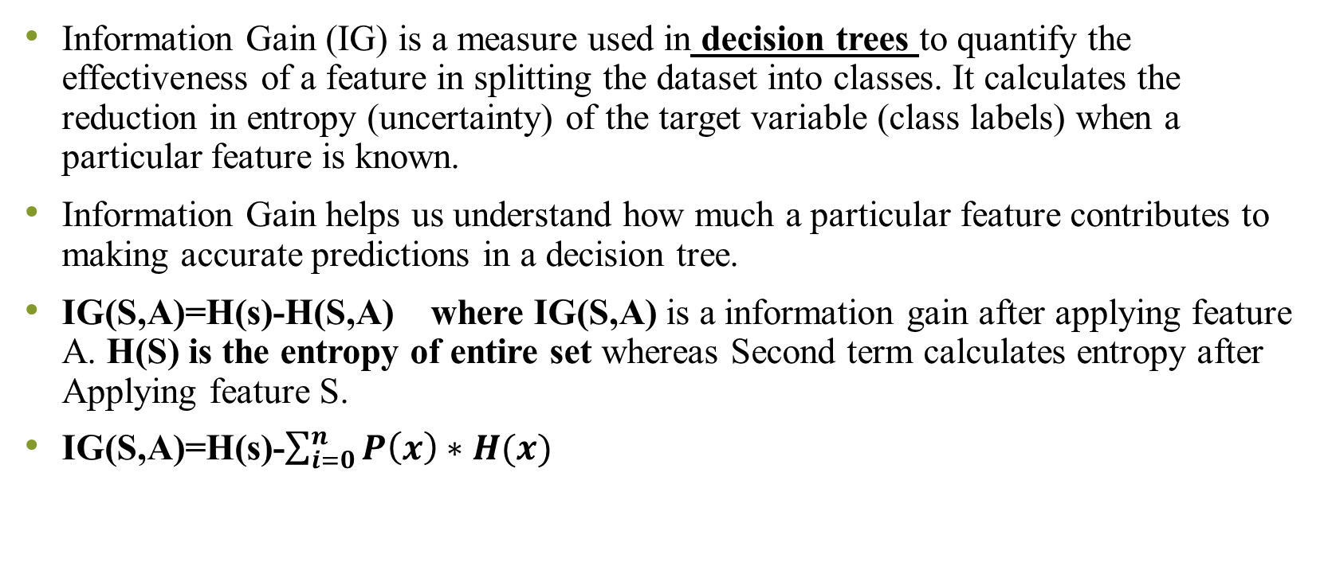
Information Gain
Information Gain (IG) is a measure used in decision trees to quantify the effectiveness of a feature in splitting the dataset into classes. It calculates the reduction in entropy (uncertainty) of the target variable (class labels) when a particular feature is known.
Information Gain helps us understand how much a particular feature contributes to making accurate predictions in a decision tree.
IG(S,A)=H(s)-H(S,A) where IG(S,A) is a information gain after applying feature A. H(S) is the entropy of entire set whereas Second term calculates entropy after Applying feature S.
IG(S,A)=H(s)-$\sum_{i=0}^{n}{P\left(x\right)∗H(x)}$

Slide 18
ID3 Algorithm Steps
Step 1: Compute the Entropy for DataSet Entropy(S).
Step 2: For every attribute/Feature:
Calculate Entropy for all other values Entropy(A).
Take Average information Entropy for current attribute.
Calculate gain for current attribute.
Step 3: Pick the highest gain attribute.
Step 4: Repeat until we get the tree we desire.

Slide 19
Benefits of pruning the decision tree
Prevention of overfitting
Improved Generalization:
Reduction in Model complexity:
Faster Decision-Making:
Robustness to Noise:
Notes:
Prevention of Overfitting: By removing branches that do not contribute significantly to predictive accuracy, pruning helps in preventing overfitting.
Improved Generalization: Pruned trees perform better on test data as they focus on the most relevant patterns in the dataset.
Reduction in Model Complexity: A simpler tree is easier to interpret, communicate, and deploy in real-world applications.
Faster Decision-Making: A smaller tree requires less computational time for classification or regression tasks.
Robustness to Noise: Pruning eliminates branches that might have been created due to noise or outliers in the training data.

Slide 20
Approaches to tree pruning
Pre-pruning(Early stopping)
This approach halts the tree growth before it becomes overly complex.
  Stopping Criteria:
    Minimum number of instances per node.
    Maximum tree depth.
    Minimum improvement in split criterion (e.g., information gain, Gini index).
Advantages
Reduces training Time
Prevents overfitting from the start
Disadvantages
Risk of underfitting as the tree might stop growing too early.
Notes:
Illustration: Suppose a tree is growing to classify students as "pass" or "fail" based on their study hours. Pre-pruning might stop the tree from further splitting if a node contains fewer than 5 students.

Slide 21
Approaches to tree pruning
Post Pruning
The tree is fully grown first and then pruned back by removing less significant branches.
Techniques:
Reduced Error Pruning
Cost-Complexity Pruning (CCP)
Notes:
Why do we prune?
Because a fully grown tree might memorize the training data (overfitting) — it performs very well on known data but poorly on new data.
Pruning helps the model generalize better to unseen data.
Types of Post-Pruning Techniques
Reduced Error Pruning
You check if removing a node (a decision point) increases the error on a validation dataset.
If removing it does not make things worse, you remove that node.
Example:
Suppose your decision tree predicts whether a person will buy a car.
There’s a small branch that says:
“If income > ₹90,000 and age = 24 and owns a cat → will buy a car.”
If removing this branch doesn’t reduce prediction accuracy, then it’s pruned (removed) because it’s too specific and not generally useful.
Cost-Complexity Pruning (CCP)
This method finds a balance between:
Accuracy (fit to data), and
Complexity (number of branches).
Each subtree is given a “cost” that increases with complexity.
The model with the lowest cost (best balance) is chosen.
Example:
Suppose you have two trees predicting whether a patient has diabetes:
Tree A: 12 splits, 95% accuracy
Tree B: 5 splits, 94% accuracy
Even though Tree A is slightly more accurate, it’s too complex.
CCP will choose Tree B, as it’s simpler and almost equally good.

